Slide 1
Predictive Modeling of In Hospital Mortality followed by Elective Surgery
By
Jahnavi Jammula Jithendra Uppalapati Sai Teja Navanth Velagaturi

Slide 2
Introduction
The dataset is taken from a open public resource https://data.cms.gov/.
This data set includes provider-level data for the hip/knee complication measure, the CMS Patient Safety Indicators, and 30-day death rates. All this data has been recorded between 2020 to 2024.
The dataset is a csv file which consists of 90,801 instances and 18 features. Some of the features are - Facility name, city, state, address, start date, end date, lower estimate, higher estimate.
Features like facility name, city, state, compared to national are categorical.
Features like Facility ID, Telephone, Denominator, Score, lower estimate are numerical.
Feature Facility ID - A unique identifier for each facility, Measure ID - specific measure being evaluated etc..

Slide 3
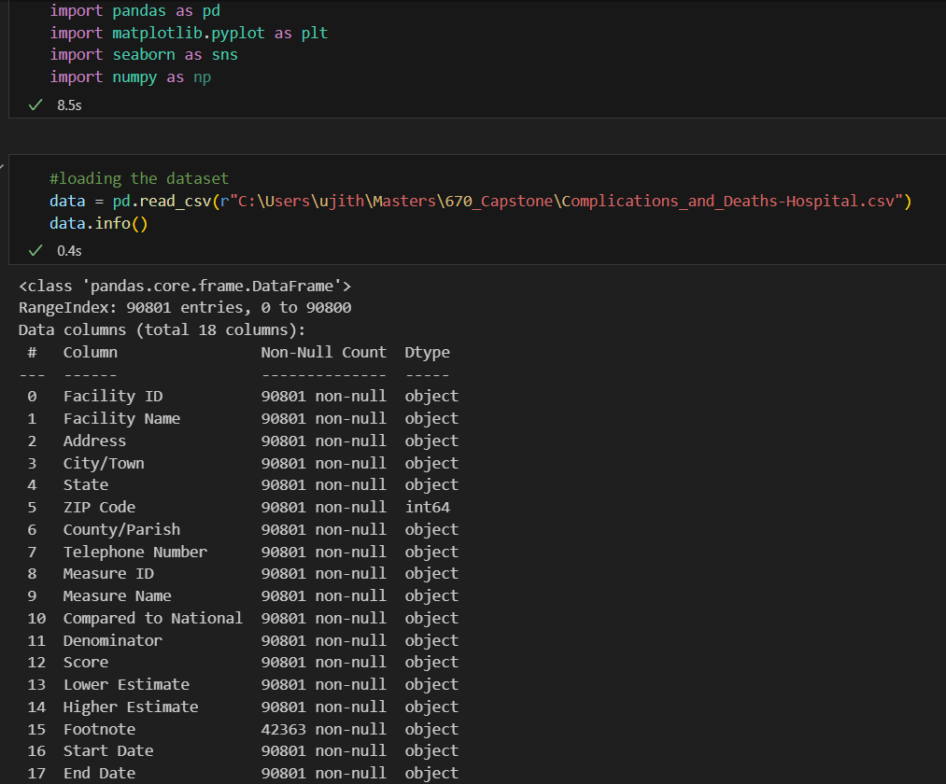
EDA (Exploratory Data Analysis)
For the Initial Data Preprocessing We have imported the necessary libraries and loaded the data. Along with Inspecting it.

Slide 4
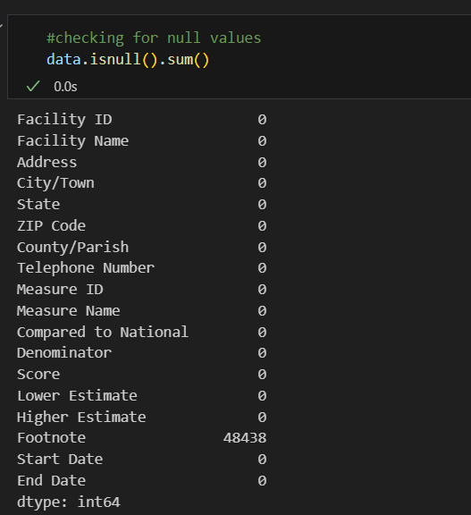
Imputation of Missing Values
We found that half the values in the footnote (additional notes) We have removed the feature footnote in the next step

Slide 5
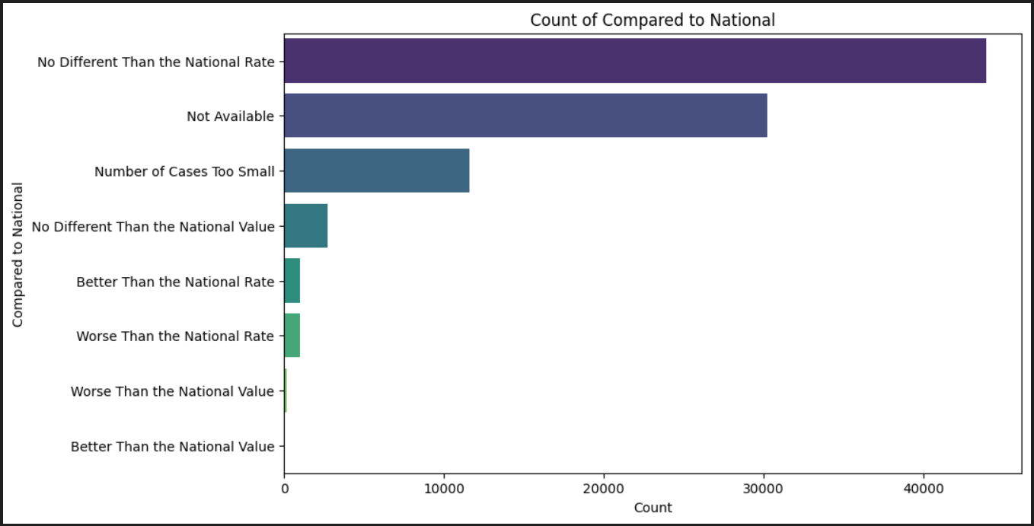
Analyzing the categorical data for Compared to National

Slide 6
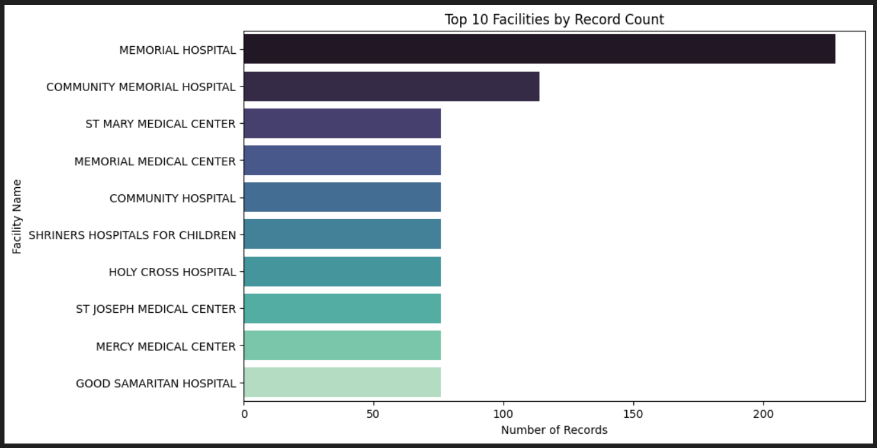
Analysing the top 10 facilities by record count

Slide 7

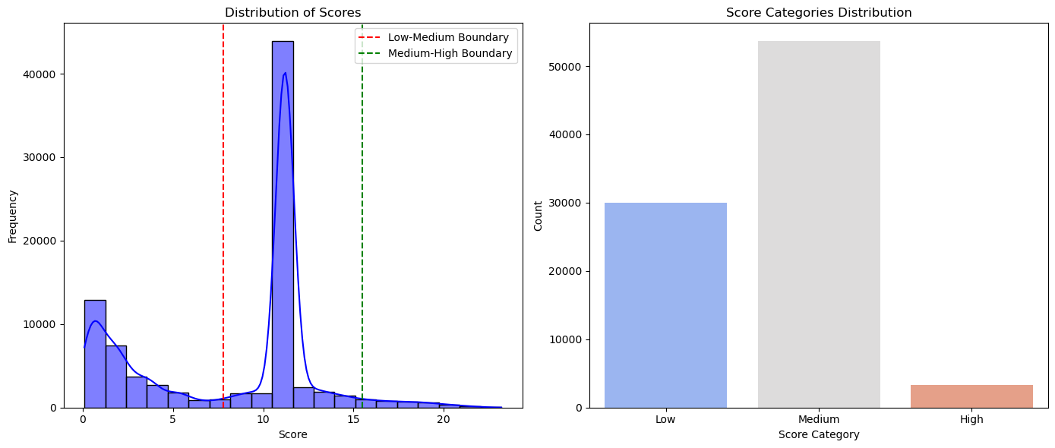
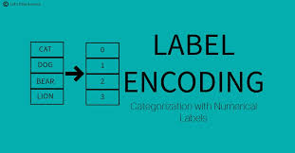
Feature Engineering
Added Features:
Surgery Season: Derived from Start Date.
Score Per Denominator: Score / Denominator.
Dropped Irrelevant Columns:
Facility-specific details and dates.
Encoding:
Label Encoding for ZIP Code, Measure ID, Compared to National.
Binning Scores:
Categories: Low, Medium, High.
Dynamic bins using np.linspace().

Slide 8
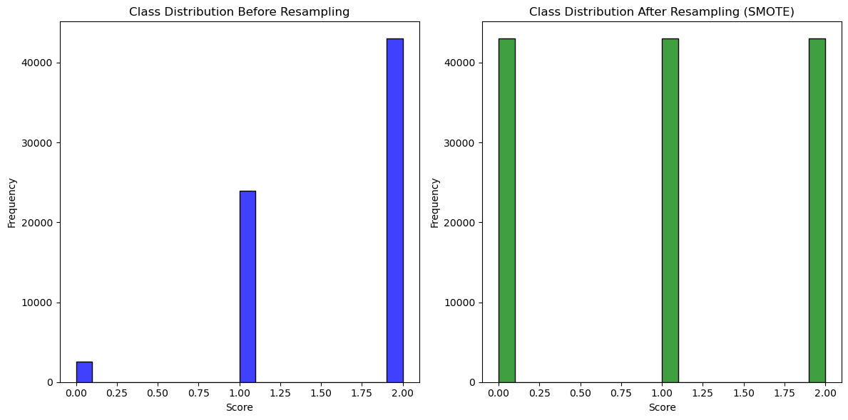
Addressing Imbalanced Data
SMOTE:
Balanced class distribution in training data.
Process:
Split and scale features.
Resample using SMOTE.
Results:
Class distribution before: Imbalanced.
Class distribution after: Balanced.

Slide 9
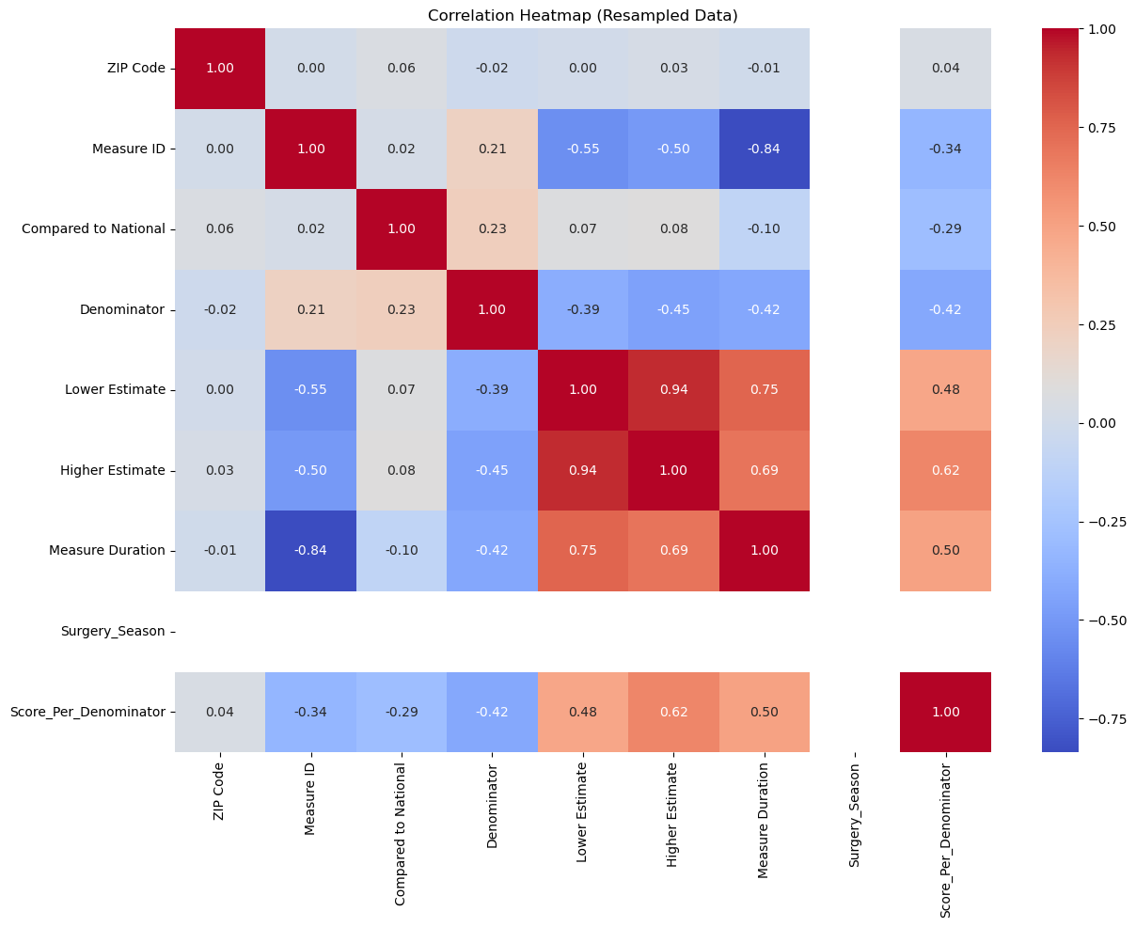
Insights & Next Steps
Key Insights:
Balanced dataset improves model reliability.
Correlation heatmap identified feature relationships.
Next Steps:
Train and evaluate the model.
Focus on impactful features.

